Slide 1
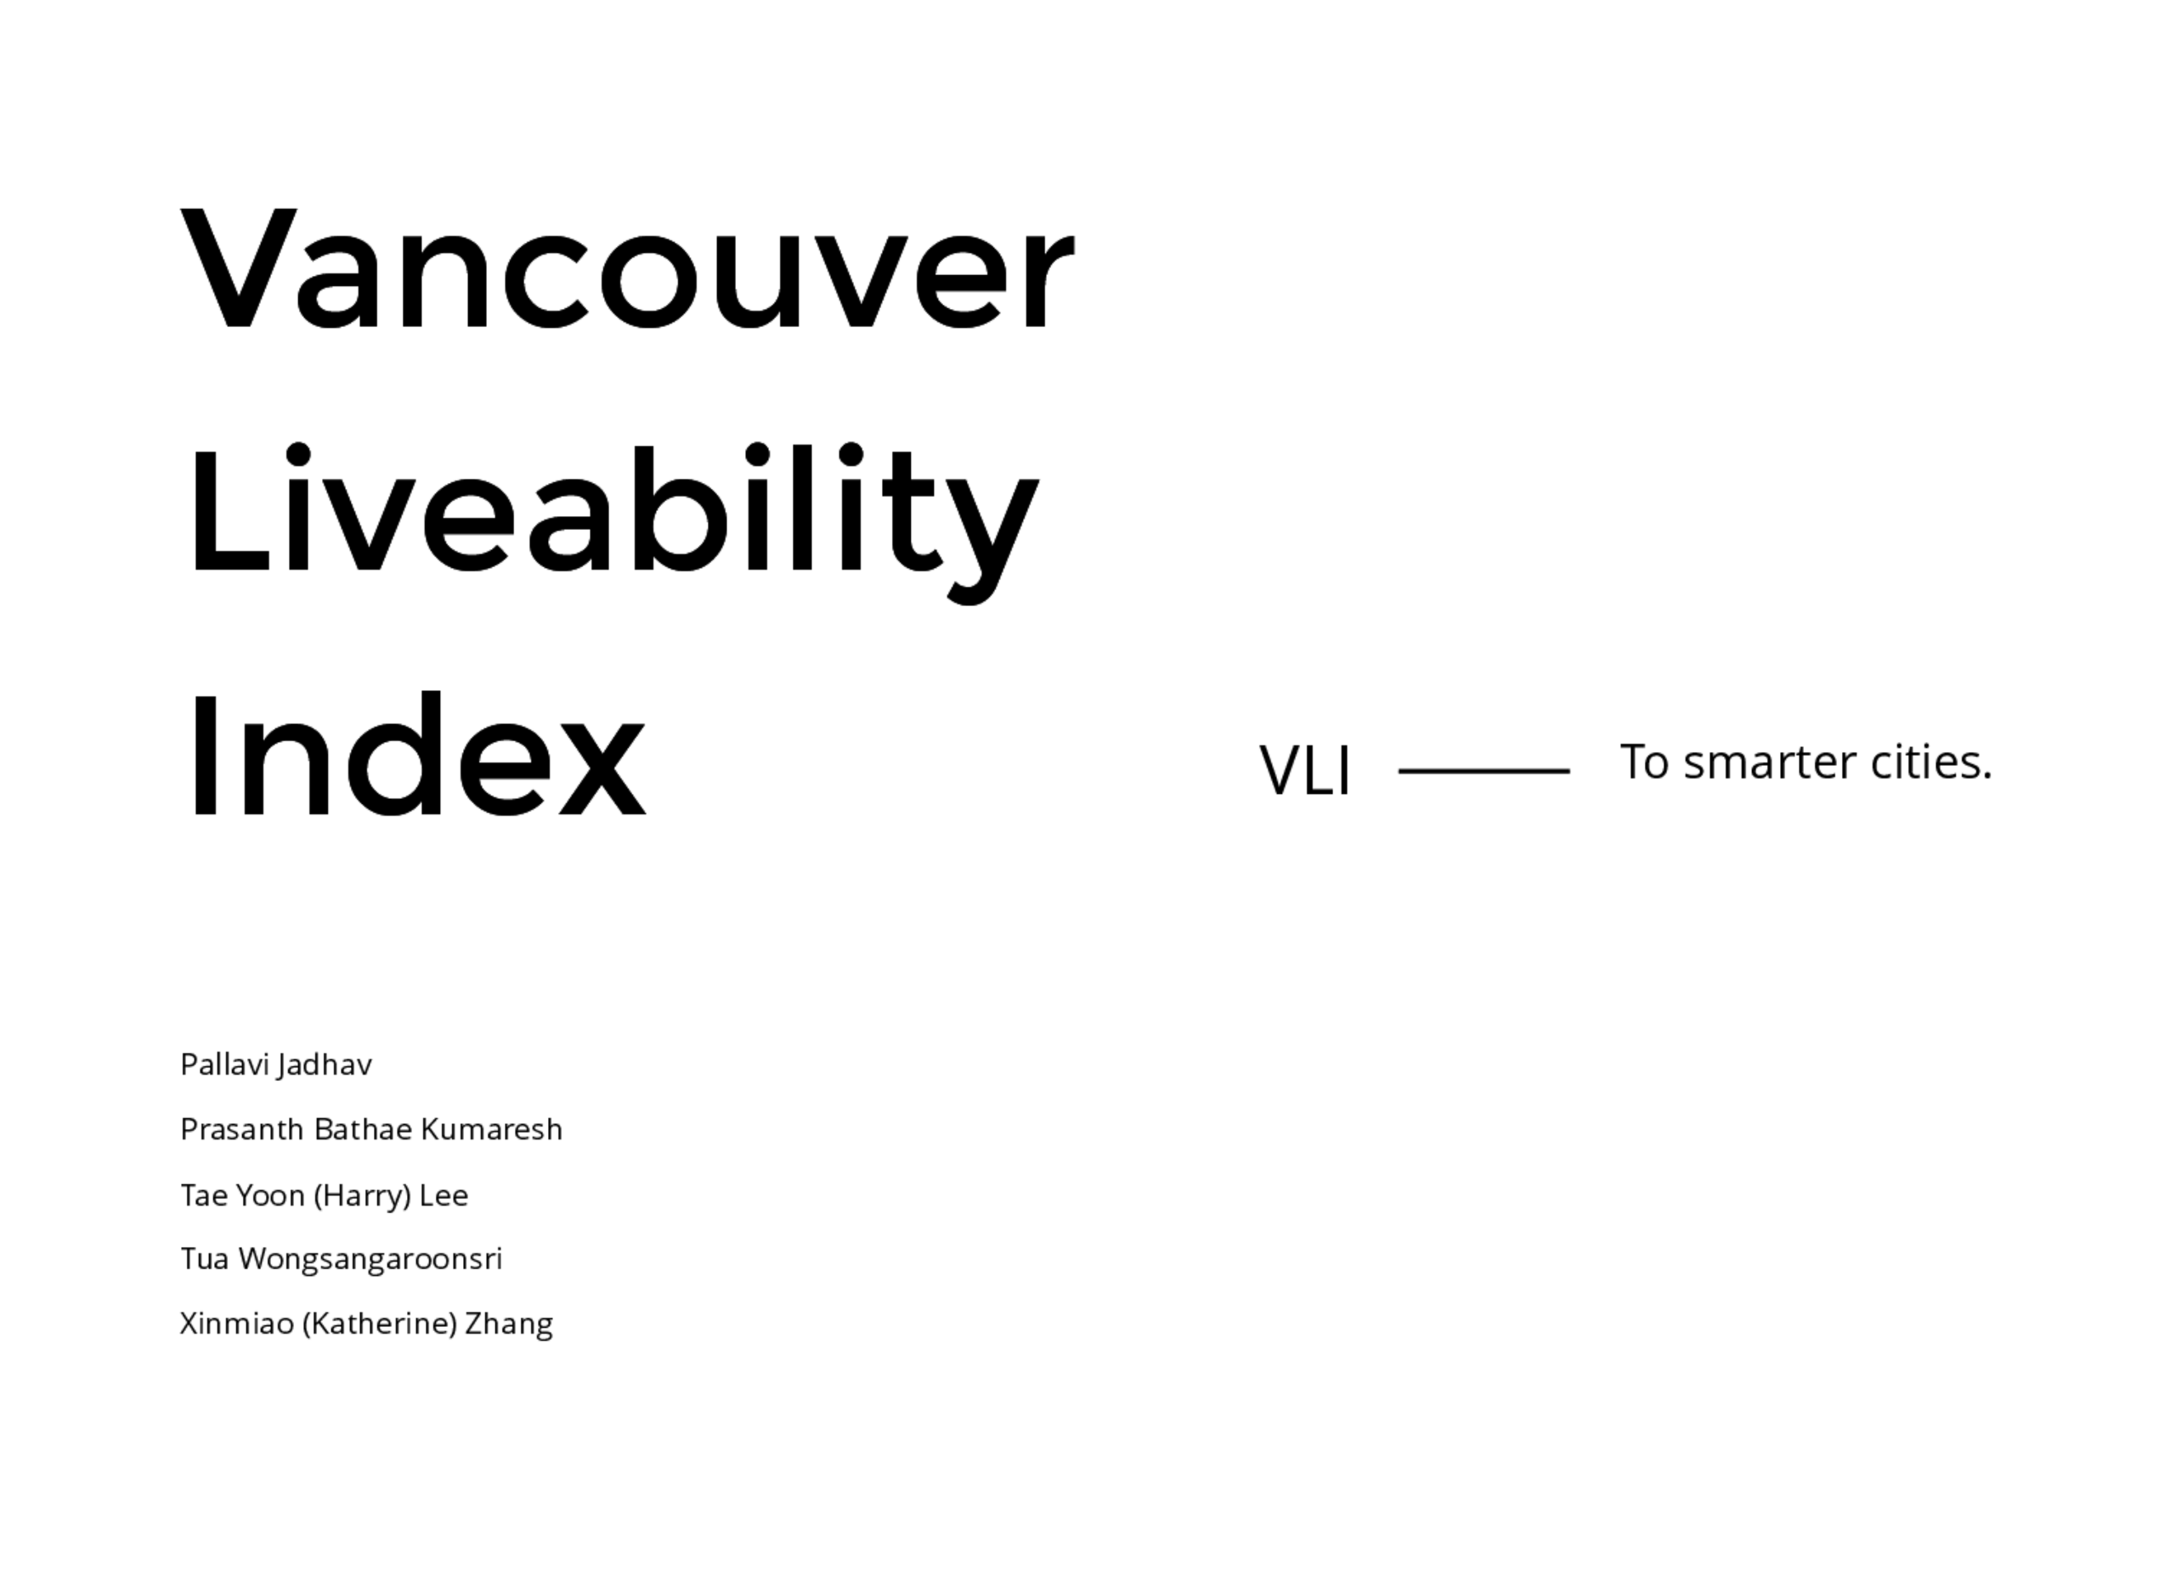

Slide 2
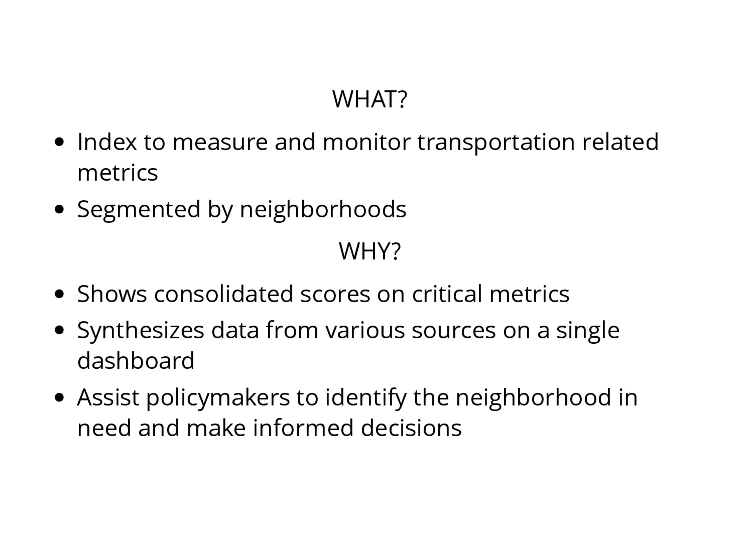
Notes:
“Water, water everywhere and not a drop to drink”, sometimes, it seems like the same way with data.
With too much data in our hands, it is hard to find systematic ways to organize them, let alone derive usable information from them.
While there are many departments that work toward developing Vancouver as the most liveable city in the world, it is difficult to
Build on cities objectives and goals
Vancouver Liveability Index (VLI), consolidates data on several key transportation related metrics and gives us a combined index on a single dashboard. This tool will help policy makers to identify the neighbourhoods in need and make an informed decision on where to spend their limited budget.
This index derives majority of its constituent components from factors called out in the “Transportation 2040” and “Climate Emergency Response” reports.
Both general public and policy makers can access this tool thereby giving improved transparency to everyone.

Slide 3
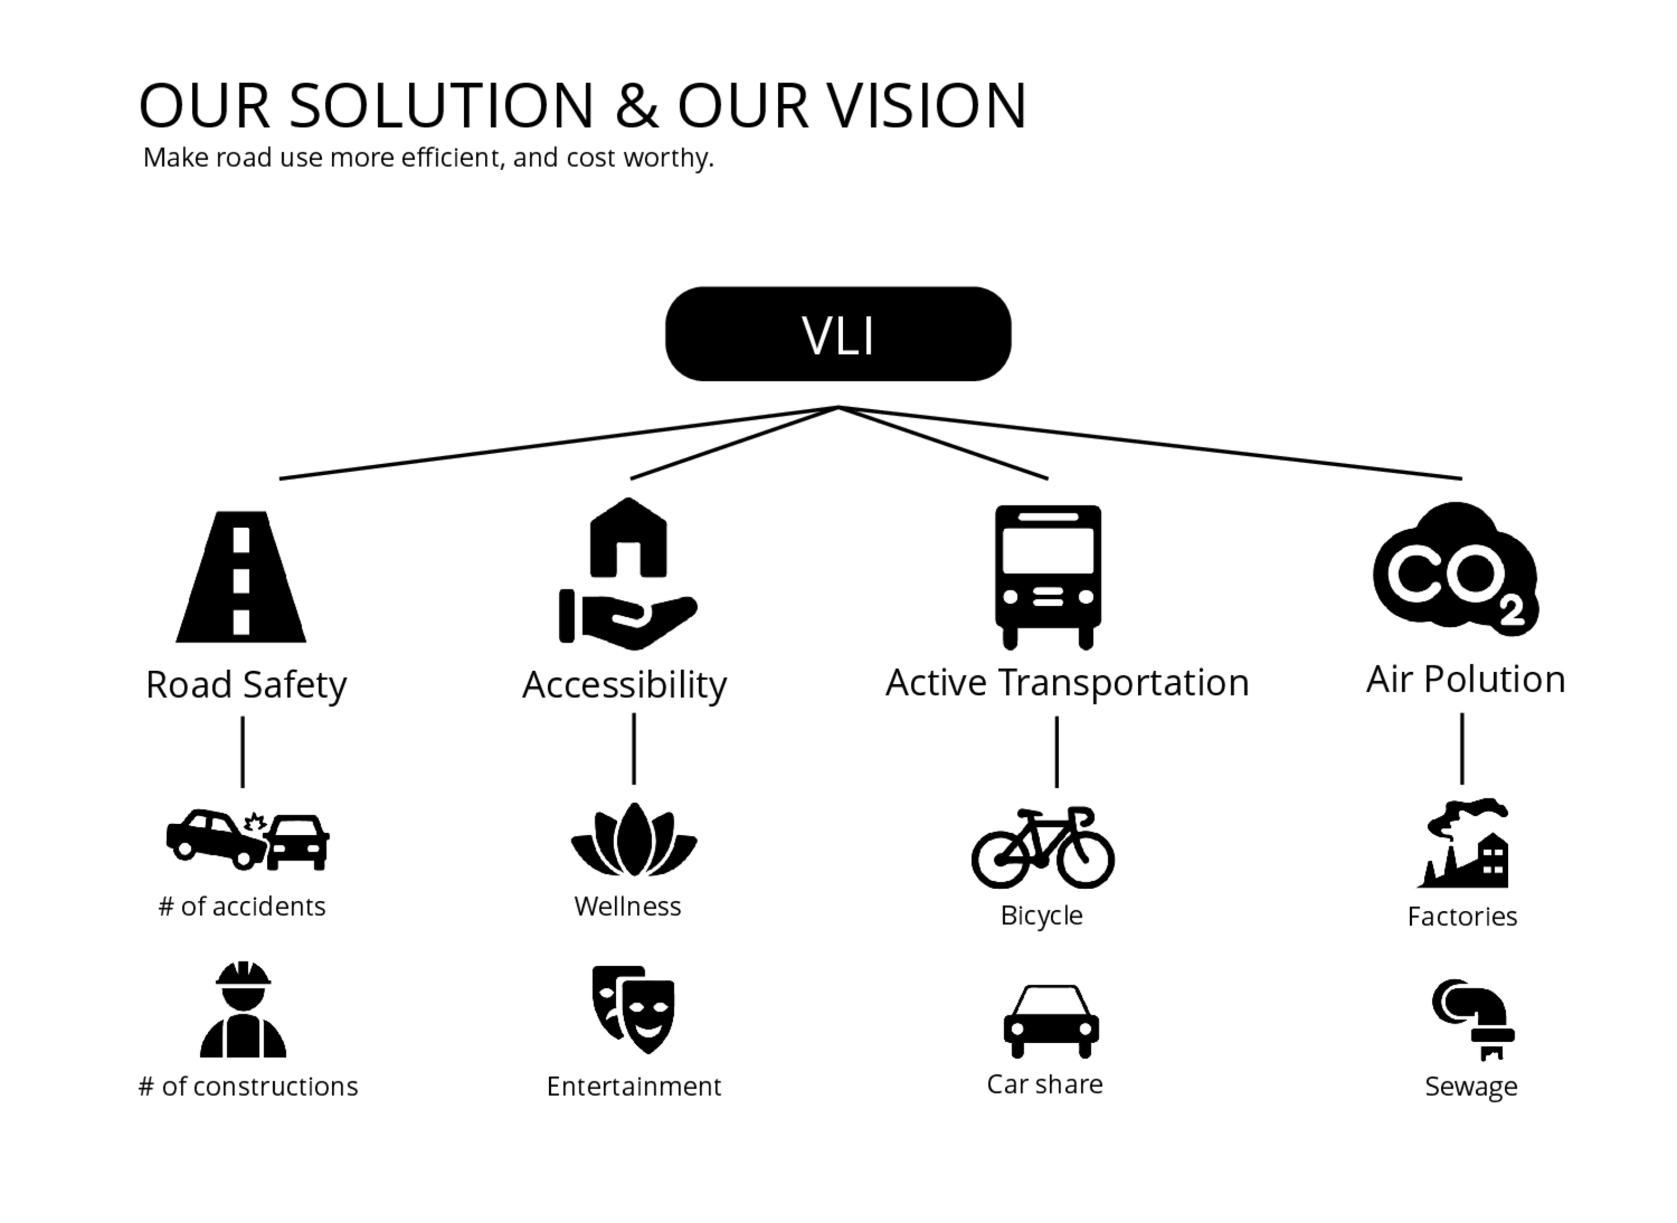
Notes:
VLI is constructed based on a modular approach as follow:
Road Safety - Focus on # of accidents, constructions, speed bumps, traffic lights, street lights. They include a collection of metrics showing traffic incidents and those which prevent them (reducing over-speeding, improving visibility and maintaining a smooth flow of traffic, thereby reducing opportunities for any traffic accidents)
Accessibility - Aligns with CER reports’ BIG MOVE #1 which calls for 90% of people living within walkable distance of their daily needs. Uses “Accessibility scores” to several key locations to calculate the overall score for various areas
Active Transportation and Transit - Inspired by CER’s BIG MOVE #2 of achieving ⅔ of trips by active transportation and transit. Measures # of bike lanes, sidewalks, transit usage, shared-car locations etc.
Air pollution - Aligns with CER’s BIG MOVE #3 of reaching 50% of kms driven by electric vehicles and BIG MOVE #4 of zero emissions Space and water heating. Metrics to measure and monitor include VKT, % of electric cars, % of new heating and hot water systems.
We have selected these modules because they align with the key objectives of “Transportation 2040” and “Climate Emergency response” (CER) reports.

Slide 4
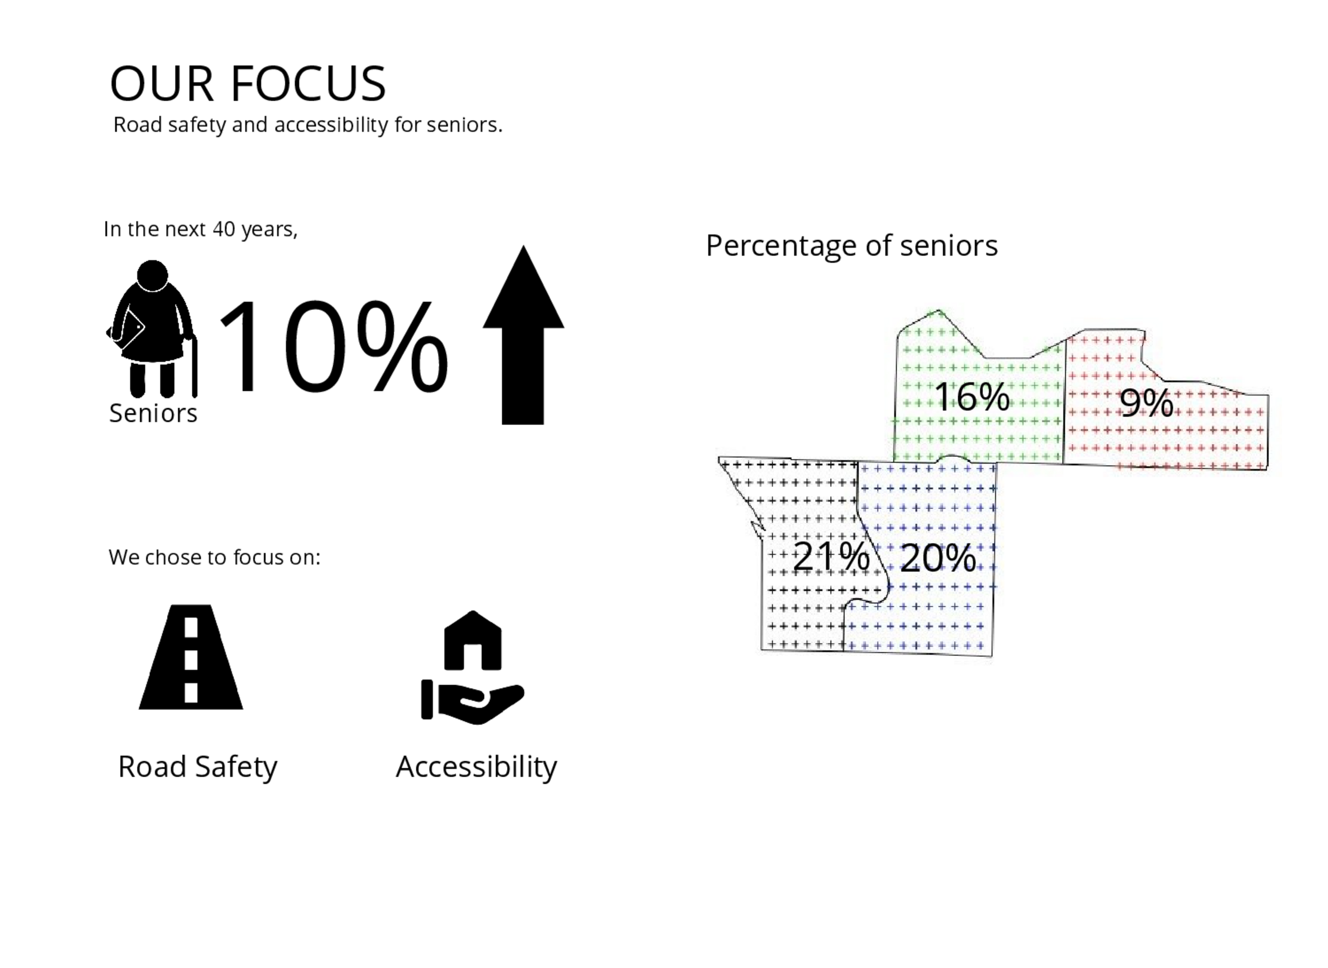
Notes:
Due to time constraints, we limited our focus to Road safety and Accessibility. We further narrowed our focus to “Senior” population (defined as people older than 65 years) as Vancouver is becoming an aging society. Since seniors are at-risk group, solutions tailor-made for them will suit everyone else in the city.
To identify neighborhoods of interest for our simulation study, we created a map of Vancouver based on percentage of seniors in each neighborhood. We then selected 4 neighbourhoods of interest (Arbutus Ridge, Shaughnessy, Fairview, Mount Pleasant) as they have very different ratio of seniors ranging from 23% in Arbutus Ridge to 8% in Mount Pleasant.
Reference: Vancouver’s aging population: https://www150.statcan.gc.ca/n1/pub/91-520-x/2019001/sect03-bc-eng.htm

Slide 5
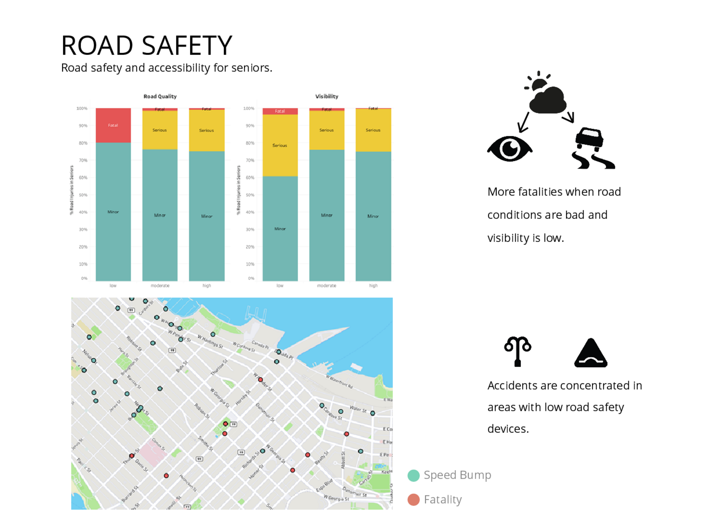
Notes:
To identify road safety, we deep-dived into causes of fatal accidents by plotting locations of accidents against road-safety devices (such as speed bumps, street lighting, curb bulges), weather conditions during the time of the accident, and type of transport. From which, we’ve gained two major insights.
Accidents are concentrated in areas with low road-safety devices
Severity of accidents are much higher during when there is low visibility due to weather conditions and poor road conditions.
These results suggest usage of various road safety devices as effective means to reduce fatal accidents. To address visibility, increase in number or brightness of street lighting during poor visibility is an option. This motivated our inclusion of the road-safety device along with the frequency of past accidents (say with a quarter lag) as the main components to compute road safety index.

Slide 6
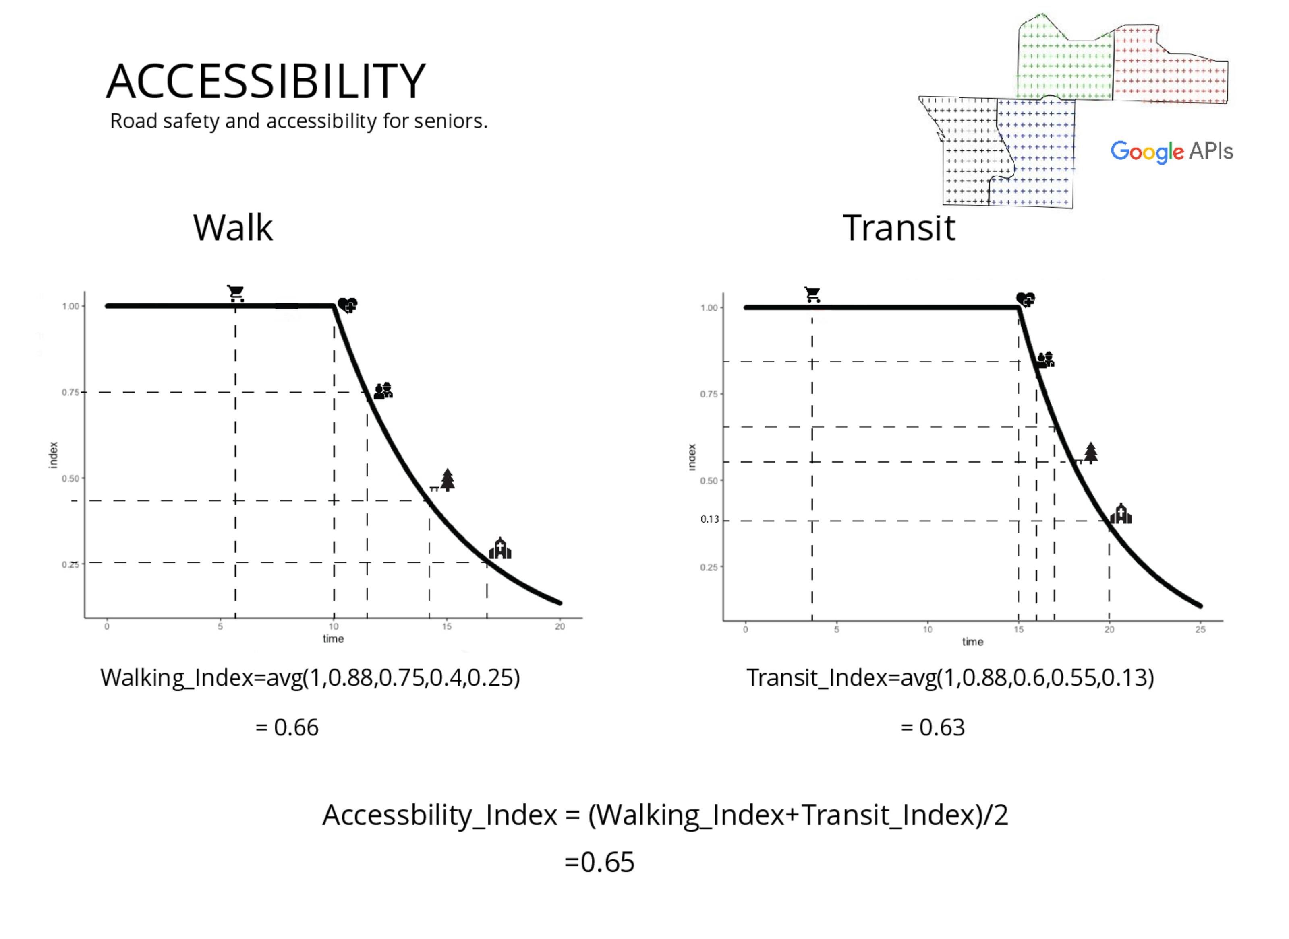
Notes:
Accessibility score index indicate how accessible the various points of interest are to people in the neighbourhood. We calculated accessibility scores based on time taken to cover distances to locations such as grocery stores, parks, hospitals, church and community centres and senior homes from 100 random points in the neighbourhoods either by walking or through transit.
Based on the time taken, appropriate index (0-1) value is assigned. Index value of 1 is assigned when walking_time < 10 mins or when transit_time < 15 mins. When times exceed those limits, index value is assigned from the decaying function.
<< Since our data of senior population is based on 2016 census, which is only available at neighborhood level, we had to assume an equal distribution of senior population throughout entire area of each neighborhood. >>

Slide 7
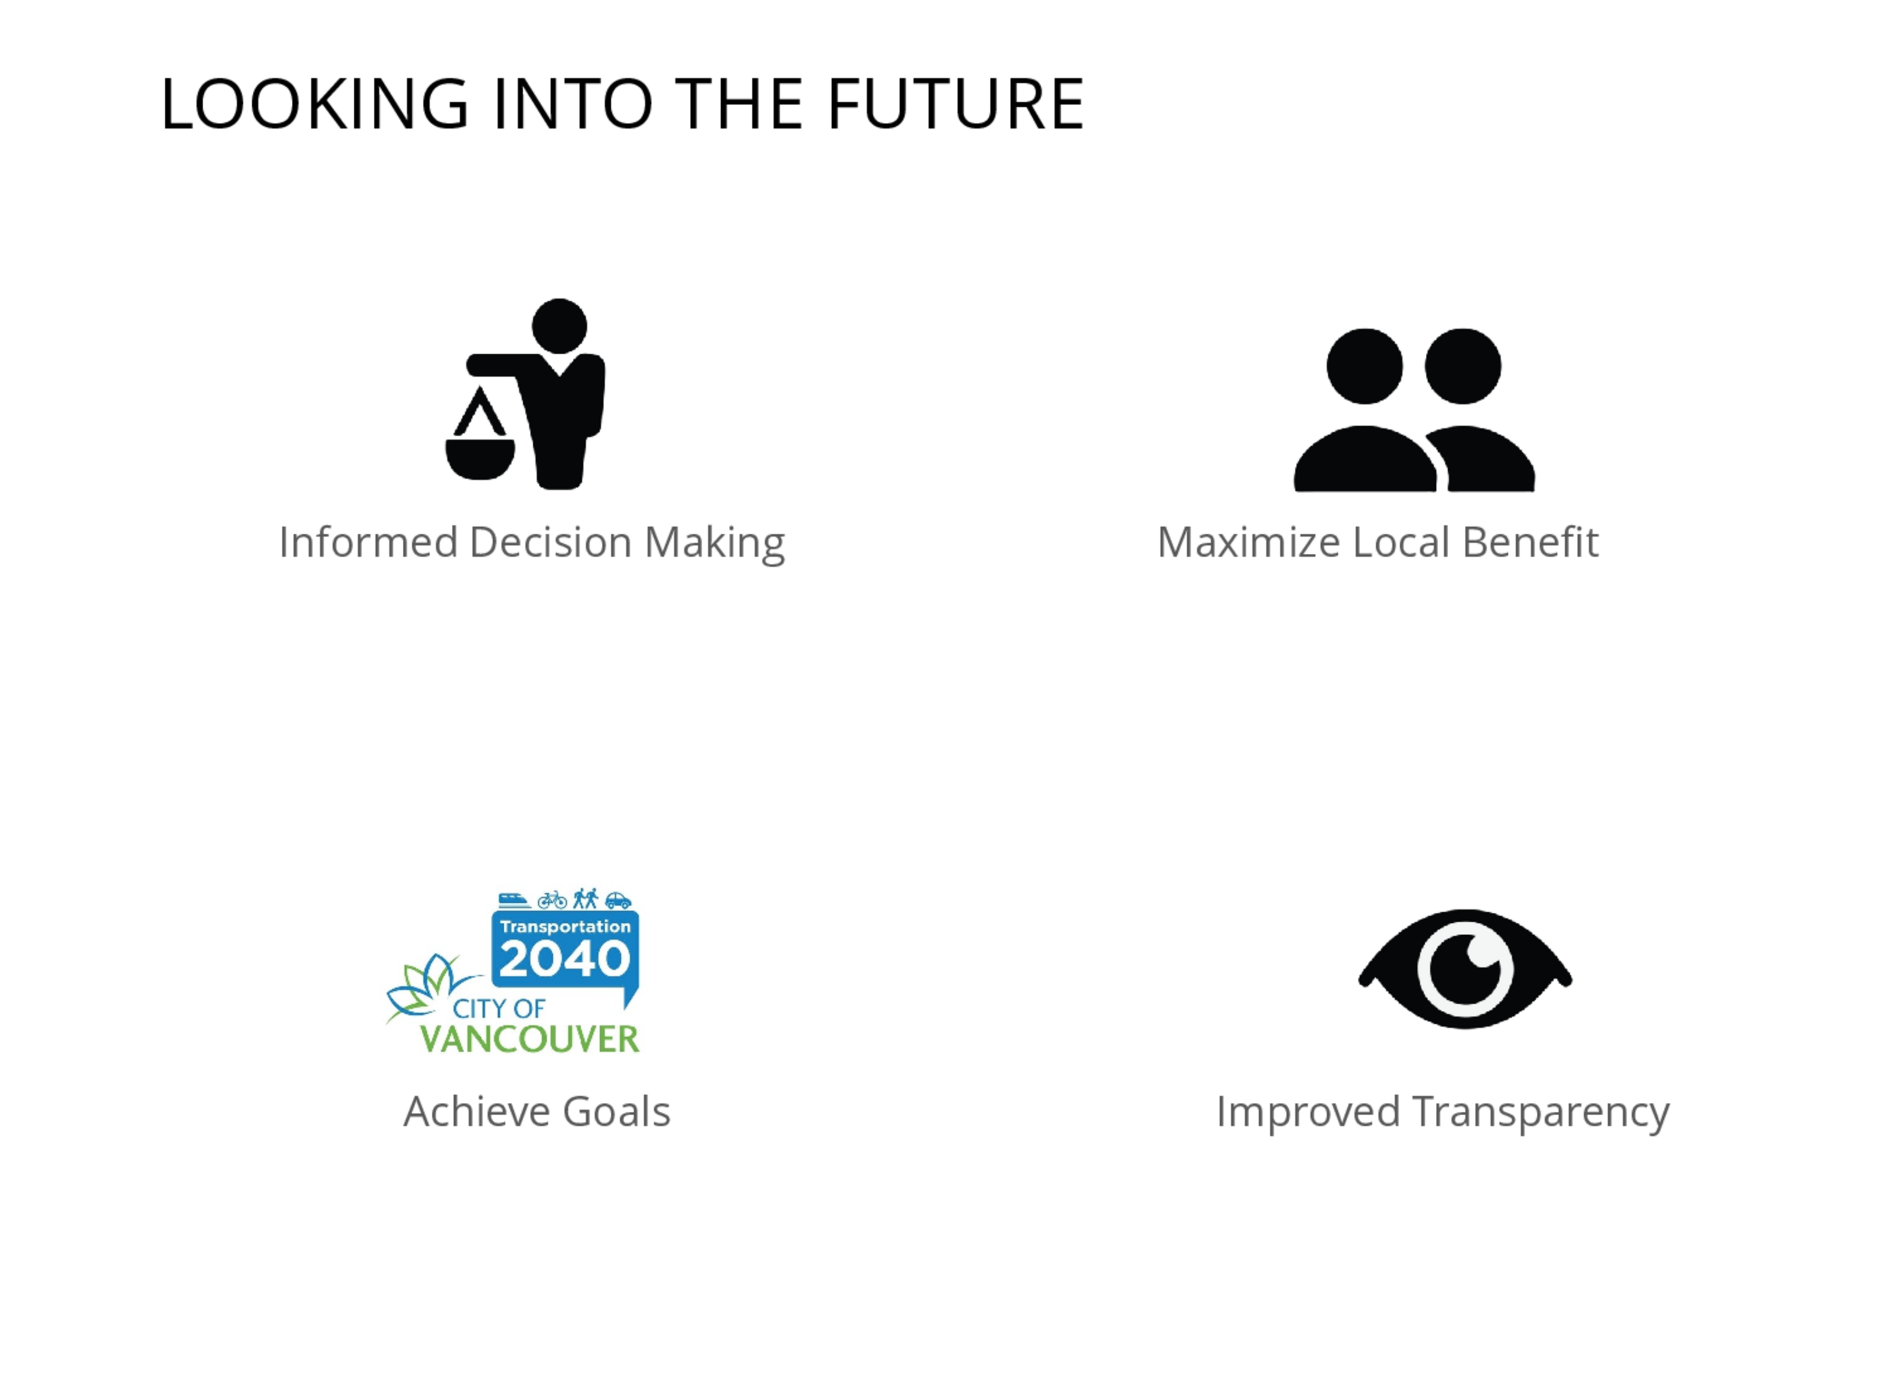
Notes:
This is the future state where all the necessary underlying data engineering has been done.
We have all the neighbourhoods scored for various metrics, which help in identifying the ones needing improvements.
If more metrics are determined, they can be added to this tool, hence we have unlimited future scalability.
COMPARISON:
Comparison between neighbourhoods can be done either cross-sectionally or by time.
Cross-sectional comparisons help in comparing two different neighbourhoods while time-series comparisons can show how a neighbourhood improved or regressed over a certain period of time. This tool is meant to aid policymaker in evaluating the effectiveness of their policy as well as in adjusting budget allocation towards neighborhood which needs more immediate intervention.
Assist policymakers in making informed decision
Solutions that maximize benefits to the local population
Keep track of metrics that are key toward achieving goals set in “Transportation 2040” and “Climate Emergency Response” reports
Improved Transparency among different agencies from “City of Vancouver” and also with the general populace

Slide 8


Slide 9


